Slide 1
Introduction to DND/CAF and Defence Analytics: In Support of the Digital Academy Practicum
Director General Analytics Support Center (DGASC)

Slide 2
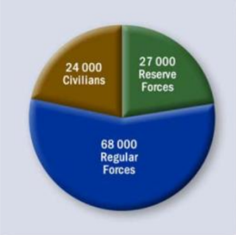
Department of National Defence and Canadian Armed Forces
DND and the CAF work together to fulfill the Canadian Government’s mission to defend Canadian interests and values, and to contribute to international peace and security
The Department of National Defence exists to carry out the work assigned to the Minister of National Defence. DND’s relationship with the CAF is that of an operations support system
DND employs approximately 24,000 Public Servants
The CAF has approximately 68,000 Regular Force and 27,000
Reserve Force members
The National Defence Headquarters is located in Ottawa in the NCR
67% of the DND population works outside the NCR

Slide 3
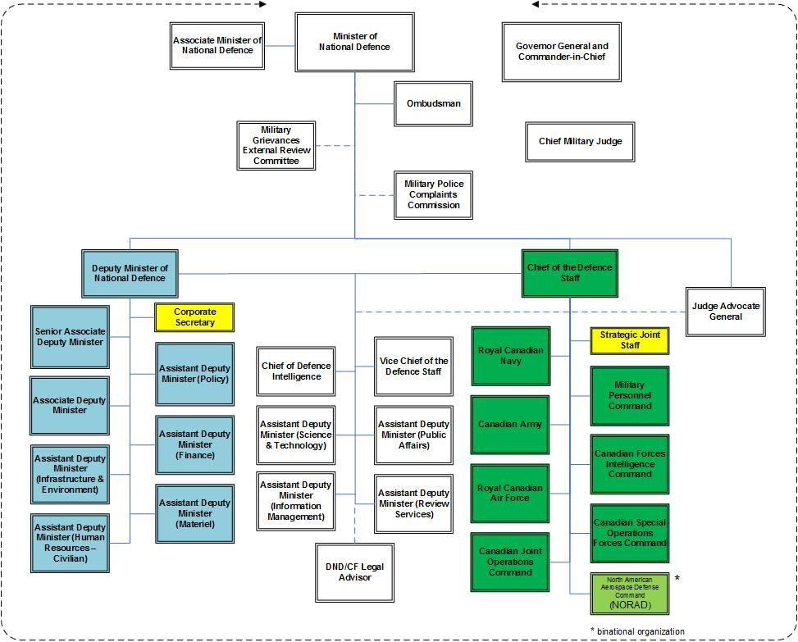
DND/CAF Organizational Structure
**Note: Assistant Deputy Minister (Data, Innovation and Analytics) is a new division that stood up in July 2018 and is not yet represented on the organisation chart.

Slide 4
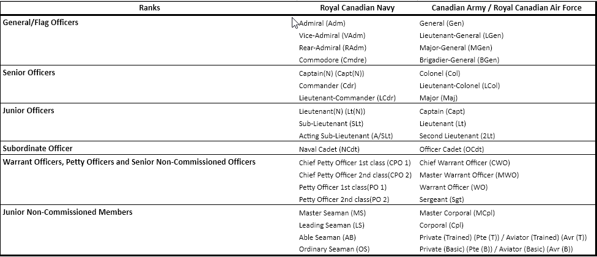
CAF Ranks and Elements

Slide 5
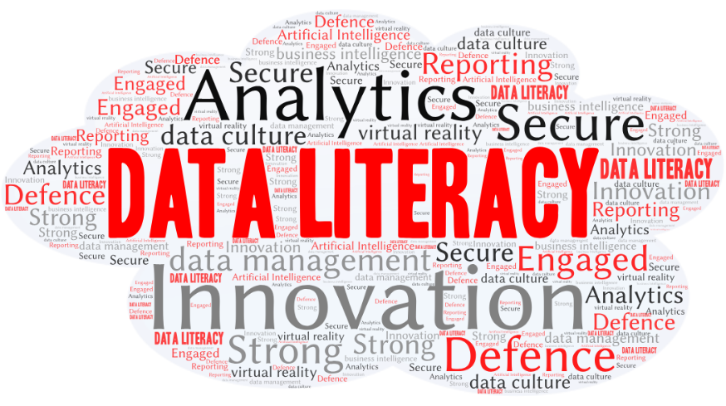
Data Literacy in DND
Building data literacy has been identified as one of the main strategic objectives in DND's
drafted Data Strategy.
Current State:
Personnel have limited understanding of the definition of data
Personnel have limited understanding of their role in maintaining data
Personnel do not have the skills to critically assess data to identify risk and evaluate quality
Personnel do not understand how to use data to improve performance and innovate
Objectives:
A workforce skilled to find data, evaluate its quality, analyze and interpret it, as well as identify and mitigate risks in using it
A data literate workforce which understands what data is and their role in maintaining data quality
A workforce with the ability to identify opportunities to use data to make decisions that create value in the organization

